Slide 1







THE MORNING AFTER A DISASTER

Slide 2

Theology of Disaster
“Love your neighbor as yourself.”
Matthew 22:39
“Bear one another’s burdens and so fulfill the law of Christ”
Galatians 6:2
Disaster Ministries within the United Church of Christ is an expression of our faith and a witness to our love for our neighbors. Our response to disasters calls us to live out our compassion and service to others.

Slide 3
“If you want to go quickly, go alone.
If you want to go far, go together.”

Slide 4
Disaster response and recovery begins and ends locally
“How we respond to disasters is just as important as the support we provide after a disaster”

Slide 5
Relationships! Relationships!
Relationships!
Assets
PEOPLE
SKILLS
MONEY
EDUCATION
ADVOCACY
CONECTIONS
FAITH

Slide 6
Mission Statement
Responding to the call of our Christ-centered faith, UCC Disaster Ministries supports holistic community recovery, worldwide, by engaging supporters, volunteers and partners to focus on preparedness, emergency relief and long-term recovery.

Slide 7
Disaster
Development
Refugee
OGHS
Undesignated

Slide 8
Undesignated
Disaster Specific
Domestic Disasters
Emergency USA
100% Programmatic Work

Slide 9
Undesignated
Disaster Specific
International Disasters
International Emergency
100% Programmatic Work

Slide 10
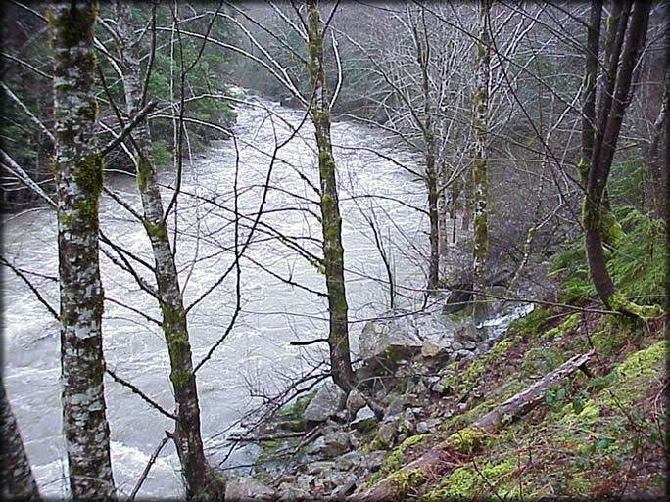
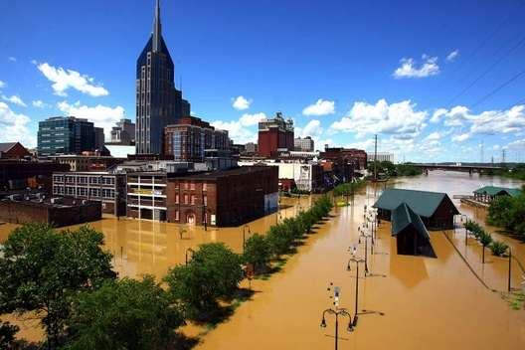
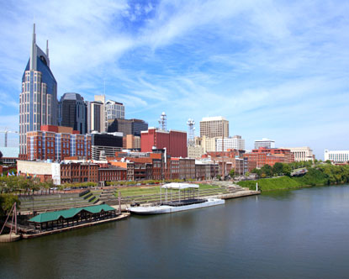
What Creates Disaster
Hazard
Vulnerability
Disaster
Town Beside a River
High Water
Flooding

Slide 11
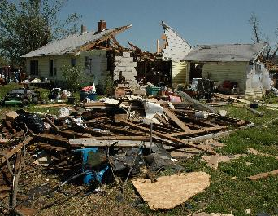
Vulnerability
All humans are vulnerable to disasters – and the trauma and devastation they bring.
However, some are more readily vulnerable than others.

Slide 12
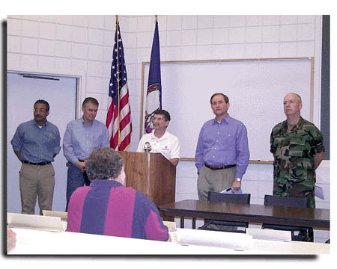
Federal Disaster Declaration Process
Governor
FEMA Regional Office
FEMA Headquarters
President

Slide 13

What happens if a disaster receives a federal declaration?
Zach Wolgemuth 10/14

Slide 14
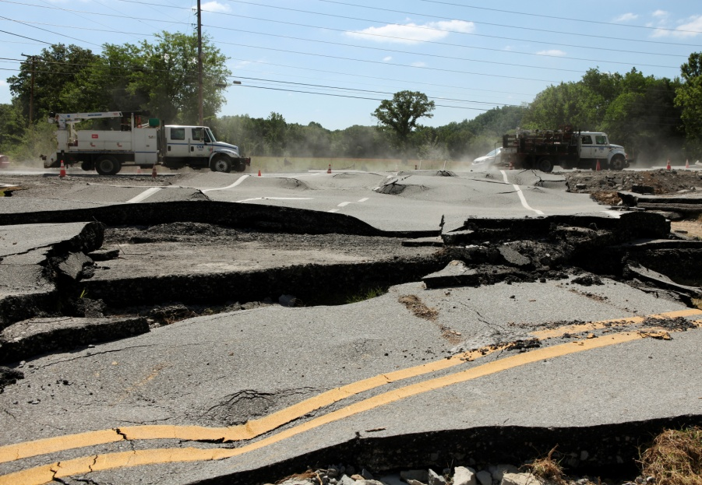
Types of Federal Assistance
Individual assistance (IA)
  Grants
  Loans
Technical assistance for human services
Infrastructure support
(Public Assistance)
Hazard mitigation
assistance

Slide 15

Sequence of Delivery
Disaster assistance programs can only be accessed in a certain order, or sequence
Process is called “Sequence of Delivery”

Slide 16
Two Possible Sequences
Sequence for delivery of assistance in disasters with federal declaration
Sequence for delivery of assistance in disasters without federal declaration, or when limited public assistance programs are available

Slide 18





Disaster Response Groups
Governmental agencies
Non-governmental agencies (NGOs)
Voluntary Organizations Active in Disaster (VOADs)
Faith-Based Organizations
Local community
Private Sector

Slide 19
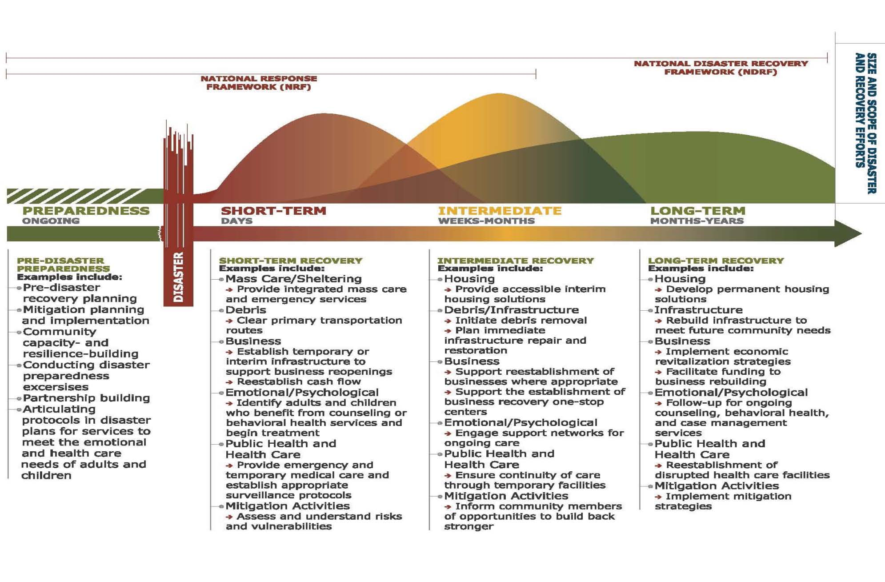
Disaster Recovery Continuum

Slide 20
Disaster Recovery Continuum

Slide 21
Disaster Recovery Continuum

Slide 22
Disaster Recovery Continuum

Slide 23


RED CROSS
TSA
SBC
ALL HANDS
WR
MDS
UMCOR
DISASTER RESPONSE ORGANIZATIONS
Disaster Recovery Continuum
GIVING TO DISASTER RESPONSE
FEMA
Center for Disaster Philanthropy

Slide 24
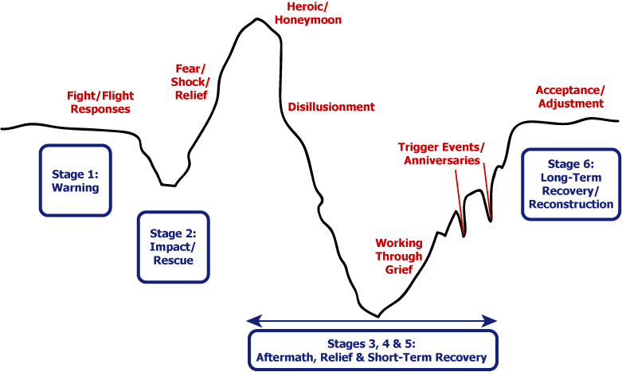
Emotional Response
Impacted
People

Slide 25
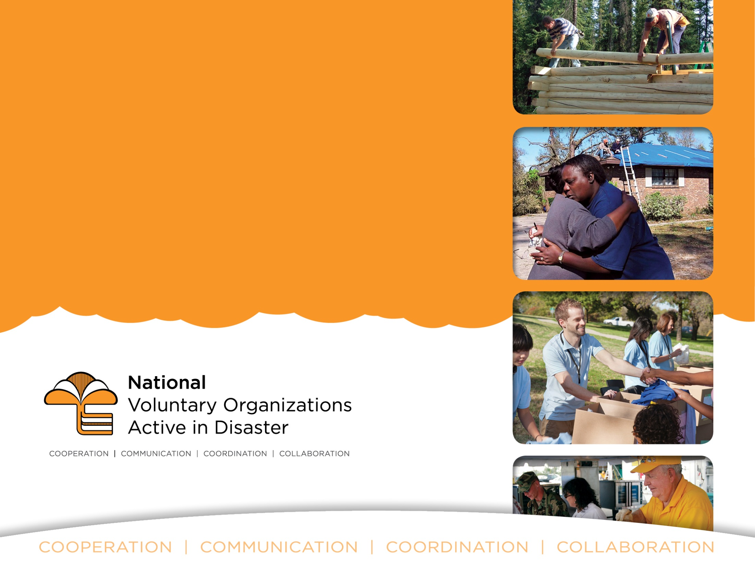
The National VOAD Movement
A Whole Community Approach

Slide 26

^{Our History}
National Voluntary Organizations Active in Disaster (National VOAD):
Founded over 40 years ago in response to the challenges many disaster ^{organizations} experienced following Hurricane Camille, a category 5 storm that hit the Gulf Coast in 1969.
As an outcome, National VOAD was formed with a Mission to be the forum where organizations share knowledge and resources throughout the disaster cycle—preparation, response and recovery—to help disaster survivors and their communities.

Slide 27
^{Our History}
^{Values}
Our commitment to caring and compassion for all people is the foundation for all we do.
A coordinated, inclusive approach provides the basis for a nurturing environment in which disaster response agencies will flourish.
The quest for excellence in National VOAD programs by encouraging best practices and mutual accountability results in operational synergy.
Our work will be accomplished in a respectful, non-judgmental and non-discriminatory manner.
Trust, mutual respect and equal partnerships of community service providers are essential elements of our work.
Providing hope – making a difference – offering opportunities for true collaboration –
are the lifeblood and soul of the organization.

Slide 28
^{Our History}
^{Core Principles}
The National VOAD collaborative practices the “4C’s” as guiding principles for how we operate and resolve conflict:
Cooperation | Communication | Coordination | Collaboration
National VOAD recognizes that these 4 C’s are progressives and based on
building and maintaining trusting, mutually capable relationships.

Slide 29
^{Our History}
1969
1970’s
1990’s
1980’s
2000’s
2010’s
During the 1980’s many local affiliates of National VOAD members began forming Local, Regional and State VOAD coalitions
2009: Partnership
Program begun
National VOAD was founded
2011: Established “Vision 2020,” expanding role of National VOAD to grow movement
By the end of the 1970’s, many other organizations joined the National VOAD Movement
By the mid-1990’s, VOAD became a true national movement

Slide 30
^{National VOAD Today}
^{110 Members (Sept.} ²⁰¹³⁾
55 National Organization Members
(Faith-based, Community-based and other Non-Governmental ^{Organizations)}
^{Membership Requirements:}
    ^{National in scope and purpose}
    Includes a Voluntary constituency component (promotes civic engagement)
    Nonprofit structure under IRS Code
    Active in Disaster cycle with documented response program
    Collaborative working relationship with other members
    Commitment of resources; build capacity of State/Territory VOADs
55 State and Territorial VOAD Members
Representing Local/Regional VOAD's/COAD’s & hundreds of additional local member organizations throughout the country.

Slide 31
^{Membership}
CRITERIA for ALL MEMBERS
Adherence to National VOAD Standards of Conduct and Service Delivery –
Transparency and Accountability:
  Non-Profit Status
  Published Form 990
  Annual audits
  Adherence to established fund raising practices such as those described by the Association of Fundraising Professionals.
Provision of one or more of the following services and participation on the associated National VOAD committee:
  Preparedness and/or mitigation
  Mass care
  Emergency assistance & casework
  Emotional & Spiritual Care
  Supporting Services to state and local VOAD member agencies
  Recovery
  Donations
  Volunteer Management
  Outreach/information and referral
  Animal and Pet Services

Slide 32
^{National VOAD Partnerships}
^{VOAD} ^{Partners}
National VOAD is dedicated to whole community engagement and recognize that all sectors of society must work together to foster more resilient communities nationwide.
National VOAD welcomes substantive partnerships with:
Emergency Management
Public Health Agencies
For-profit Corporations
Foundations
Educational and Research Institutions
Associations
Other Nongovernmental Organizations

Slide 33
^{National VOAD Today}
^{Committees:}
  ^{Advocacy}
  ^{Communications}
  ^{Community Preparedness}
  ^{Disaster Case Management}
  ^{Disaster Health}
  ^{Donations Management}
  ^{Emotional & Spiritual Care}
  ^{Housing}
  ^{International}
  ^{Long Term Recovery Groups}
  ^{Mass Care}
  ^{United States Islands & Alaska}
  ^{Volunteer Management}
Task Forces:
  Drought
  Training
Documents from the Committee's:
^{Points of Consensus:}
  ^{Disaster Case Management}
  ^{Disaster Spiritual Care}
  ^{Donations Management}
  ^{Mass Care}
  ^{Rebuild & Repair}
  ^{Volunteer Management}
  ^{United States Islands & Alaska}
^{Other Documents:}
  ^{Multi Agency Feeding Template}
  ^{Light Our Way}
  ^{Long-Term Recovery Guide}
  ^{Managing Spontaneous Volunteer}
  ^{National Mass Care Strategy}
  ^{Drought} ^{Response} ^{Guide}

Slide 34
^{National VOAD Movement}
State/Territory VOADs
National VOAD Member Organizations
Local/Regional – VOAD/COADs
Communities
National VOAD
All disasters start & end locally

Slide 35
What Gaps Exist
No single organization or government program can address everyone’s needs following a disaster.
What is the UCC’s role(s)?
What other organizations respond to disasters?
  How?
  When?
  What services do they provide?
  Where, when, how do they work together?
Where do gaps exist along the continuum?

Slide 36
Importance of a
Focused Role
No single organization or government program can address everyone’s needs following a disaster.
Resources
Capacity
Professionalism
Consistency
Dependability
Training
Expertise
Standards
Trustworthiness
Partnerships

Slide 37
Empowering Survivors
Disaster Survivors
Volunteers
Congregation
CD Team
CDC/Conf.
DM

Slide 38
UCC DM Focus (Domestic)
Focus on Preparedness and Long-Term Recovery Rebuilding
Provide support and resources to Conferences and Congregations
Train Long-Term Volunteers in Recovery to be deployed as needed
Share volunteer opportunities for disaster recovery work teams
Provide Grants to and/or through the UCC Conferences.
Provide Grants to partners throughout the entire Response and Recovery Continuum
Influence Federal policy and disaster response and recovery best practices
Disaster Recovery Support Initiative (DRSI)
Support Long-Term Recovery (not first to arrive but often last to leave)
Notes:
We won’t be the first to respond be we will be the last to leave.
“You came and You Stayed”
“You allowed us to use the funds for what we needed most”
“You asked what we needed and you listened”
“We would have needed to end our recovery work if you hadn’t continued to support us”
Typhoon Maysak
Super Typhoon devastated Micronesia islands of Chuuk and Yap (strongest pre-April typhoon on record)
Working closely with Hawaii conf. connections to Micronesia Council of the United Church of Christ

Slide 39




Domestic Partners

Slide 40
CDC Role (Domestic)
Focus on Preparedness and Long-Term Recovery Rebuilding.
Build a Conference Disaster Team and develop the Disaster Ministries network within the Conference.
Respond to disasters with the conference by determining needs, appropriate response and disseminating information.
Request the appropriate type of support from UCC Disaster Ministries at the appropriate time.
Notes:
We won’t be the first to respond be we will be the last to leave.
“You came and You Stayed”
“You allowed us to use the funds for what we needed most”
“You asked what we needed and you listened”
“We would have needed to end our recovery work if you hadn’t continued to support us”
Typhoon Maysak
Super Typhoon devastated Micronesia islands of Chuuk and Yap (strongest pre-April typhoon on record)
Working closely with Hawaii conf. connections to Micronesia Council of the United Church of Christ

Slide 41
Preparedness
Being prepared allows for:
  Supporting others
  Encourages others to be prepared
  Frees limited resources
  Prepared individuals and churches become part of the recovery rather than part of the disaster

Slide 42
http://www.ready.gov
http://www.fema.gov
http://training.fema.gov
http://www.nvoad.org

Slide 43
Church Preparedness
Continuity of operations planning
  How will you hold worship services after a disaster?
  Do you have important documents saved?
  How will you be in communication with members?
  Who’s in charge?
Response planning
  Do you have evacuation plans?
  Do you have plans to provide shelter?
  How will you handle donations / Should you handle donations?
  What is your capacity to provide ____ service?
  Does the local government /others know you are able to provide ____ service?

Slide 44
Individual Preparedness
Response planning
  Do you have evacuation plans?
  Do you have plans to shelter in place?
  Do you have an evacuation plan?
  Do you have a kit for sheltering in place?
  Do you have an evacuation kit?
  Are important documents in more than one secure location?
  Are important emergency contacts in place?

Slide 45
Early Response
Early response requires pre-planning focus and flexibility
Communication throughout the disaster ministries network (CDC, Conf., National Setting and Network of Partners)
Prior relationships, understanding of needs and clear understanding of the process.
Clearly defined goals and objectives

Slide 46
Congregational Response
Be Patient!
  Recovery is Long-Term (Months to Years)
PAY, PRAY, STAY http://www.cbsnews.com/videos/disaster-relief-donations-that-dont-bring-relief
You don’t have to “fix” it all… and you can’t!
  There are a multitude of organizations that provide different services and support after a disaster.
Be careful to think through your response!
  Is it appropriate? Not all responses have a positive impact.
Use the existing structures to your benefit.
  There is no need to recreate the wheel.
Document Everything!

Slide 47
Congregational Response
Use your contact tree to identify any members that have been impacted.
Share information about where/how they can receive support. (MARC, 211, etc.)
Join conference calls to glean information(VOAD, COAD)
Provide information about appropriate ways to support response/recovery.
Focus on your role as the congregational leader
  Allow others to take on coordination of volunteers, information sharing, etc.

Slide 48
Long-Term Recovery
That time following a disaster in which agencies and organizations help affected persons and communities to develop and implement plans and structures for an extended recovery over a period of time in order to address unmet needs.

Slide 49
Long-Term Recovery
Relationships, Relationships, Relationships!
Every community is unique, every disaster is different, every response is one of a kind.
Recovery begins and ends locally
Identifying “unmet” needs (Case Management)
Collaborative unbiased recovery focused on vulnerable populations

Slide 50
Who Has Unmet Needs?
People who fall through cracks for receiving critical assistance and support.
People who will not receive enough aid for required repairs or rebuilding to restore safe, sanitary, secure home.

Slide 51
Long-Term Recovery Group (LTRG) Model
To draw upon community assets and resources to effectively and efficiently coordinate and respond to unmet long-term needs within a community.

Slide 52
INDIVIDUAL
RESOURCES
PERSONAL SAVINGS
RECOVERY NEEDS
TEMP HOUSING
MORTGAGE
LABOR
GRANTS / LOAN
MATERIALS
INSURANCE ?

Slide 53
LTRG RESOURCES
GRANTS / LOAN / INSURANCE
VOL LABOR
RECOVERY NEEDS
TEMPORARY HOUSING
PERMANENT HOUSING
LABOR
MATERIALS
MATERIALS
$

Slide 54
Collaboration Within the LTRG
Common Goal: Help survivors that have unmet needs
Sets goals and standards appropriate for its community
Eliminates duplication of services, resulting in a more efficient response.
Expands resource availability.
Engages a wide variety of local, regional and national partners.
Enhances problem solving through cross pollination of ideas.
Ensures available resources are used for the recovery.

Slide 55
Ingredients for a Successful LTRG
Commitment to a common goal of responding to unmet needs of individuals and families in the community.
Commitment to participate in shared
decision-making.
Willingness to share information, resources, and tasks.
Professional sense of respect for individual team members.

Slide 56
LTRG Members
LTRG
Pastors
Local Government
Concerned Citizens
Local Social Service Leaders
Representatives from response organizations
Business Owners
*Recovery Group should represent the diversity of the community being served.

Slide 57
Components of a LTRG
LTRG
Resource Development
Donation Management
Spiritual and Emotional Care
Volunteer Management
Construction Management
Case Management
Advocacy
Communications

Slide 58
Disaster Case Management
Case management is a critical component of long-term recovery assistance
Process includes:
  Needs evaluation
  Confirmation of assistance received
  Identification of unmet
  needs and planning to
  address unmet needs

Slide 59
Example
Jane Doe:
  $65,000 damage to house
  Car destroyed
  No insurance
  Did not qualify for SBA Loan
  Continued Mortgage payment
  Rent/expenses per month $500 in excess of salary
Resources:
  Savings $12,000
  FEMA MAX Grant $32,900

Slide 60
Example (6 months later)
Jane Doe:
  Total Cash Resources $44,900
      - $12,000 to purchase vehicle (needed for work)
      - $3,000 Excess expenses (above salary)
  Total cash assets after 6 months = $29,900
  Total Unmet need = $65,000
      Labor = $25,000
      Materials = $40,000
Total Financial Deficit/Unmet Need: $35,100

Slide 61
LTRG Response
Total Financial Deficit/Unmet Need: $35,100
      $25,000 (Labor)
      $10,100 (Const. Materials)
LTRG Response:
      In-Kind sheetrock ($1,500)
      Grants/donations from LTRG ($8,600)
      VOAD agency labor ($25,000)

Slide 62
Volunteer Management
Hosting
Orientation
Planning work
Coordinating people
Working with other agencies and media
Coordinating construction

Slide 63
Hosting Responsibilities
Housing
Food
Transportation
Recognition and celebration

Slide 64
At First Contact
(prior to arrival)
Introduce project and needs
Introduce tasks
Send required forms

Slide 65
Orientation
(upon arrival)
Give the big picture
Address concerns; answer questions
Safety Issues
Set appropriate expectations
Provide key information
  About disaster
  About community
  About recovery effort

Slide 66
Planning Components
Volunteer job descriptions
Matching jobs and skills
Tracking volunteer hours
Setting high standards
Planning for proper management

Slide 67
Task Descriptions
Define the job
  Purpose
  Responsibilities and tasks
  Skill requirements
  Reporting relationships

Slide 68
Match Jobs and Skills
Identify skills
  Use Individual Volunteer Survey
Find best job for each volunteer
  All volunteers should be utilized and supported

Slide 69
Track Volunteer Hours
Track all volunteer time on projects
Use information to show recovery project contributions when requesting grants

Slide 70
Disaster Spiritual Care
Respect for diverse Faith Traditions
Concern for confidentiality
Do not Proselytize or Evangelize in the context of Disaster Spiritual Care
Respect for Social Diversity
Provide a calm listening presence

Slide 71
Who may need Spiritual Care
Individuals/families/communities:
  Lost homes / displaced
  Lost businesses or livelihoods
  Lost loved ones / family, friends
  Separated families
Injured people
Emergency Personnel
Relief workers
Community leaders
Pastors
Hospital workers
Law enforcement

Slide 72
Questions and needs related to Spiritual Care
Struggles of faith and meaning
Desire for religious/spiritual resources
Need for contact and sense of belonging/community
Need to gather with and share with other disaster survivors

Slide 73
International Response
Provide lifesaving support throughout the entire disaster cycle.
Collaborate with partners to engage in underserved communities and to fill gaps in services.
Engage local leadership to ensure disaster relief and recovery is equitable and culturally appropriate.
Build capacity of local communities through technical and financial support.
Notes:
We won’t be the first to respond be we will be the last to leave.
“You came and You Stayed”
“You allowed us to use the funds for what we needed most”
“You asked what we needed and you listened”
“We would have needed to end our recovery work if you hadn’t continued to support us”
Typhoon Maysak
Super Typhoon devastated Micronesia islands of Chuuk and Yap (strongest pre-April typhoon on record)
Working closely with Hawaii conf. connections to Micronesia Council of the United Church of Christ

Slide 74
International
Response

Slide 75
International Updates
Japan Earthquakes
Nepal Earthquake
Philippines Typhoon
Fiji Cyclone
Ecuador Earthquake
Notes:
We won’t be the first to respond be we will be the last to leave.
“You came and You Stayed”
“You allowed us to use the funds for what we needed most”
“You asked what we needed and you listened”
“We would have needed to end our recovery work if you hadn’t continued to support us”
Typhoon Maysak
Super Typhoon devastated Micronesia islands of Chuuk and Yap (strongest pre-April typhoon on record)
Working closely with Hawaii conf. connections to Micronesia Council of the United Church of Christ

Slide 76
2015 International Disaster Responses
Sri Lanka (Floods)
India (Floods)
Pakistan (Earthquake)
Ecuador (Volcano)
Malawi (Flooding)
Lao People's Democratic Republic (Floods)
Myanmar (Cyclone)
Nepal (Earthquake)
Madagascar (Cyclone Chedza)
Vanuatu (Cyclone Pam)
Mozambique (Flooding)
Angola (Flooding)
Korea (Flooding)
Philippines (Typhoon Haiyan)
Japan (Earthquake / Tsunami)
Haiti (Earthquake)
Iraq (Fire)
China & Taiwan (Typhoon Soulelor)
Philippines (Typhoon Lando)
Malawi (low food production due to weather)

Slide 77
2016 International Disaster Responses
Fiji (Tropical Cyclone)
Ethiopia (Drought, Hunger)
Democratic Republic of Congo (Floods)
Nepal (2015 Earthquake)
Philippines (2013 Typhoon Haiyan)
Zimbabwe (Drought)
Taiwan (Earthquake)
Japan (Earthquake)
Ecuador (Earthquake)

Slide 78
How to Support
Prayers
Keep volunteering
Financial support
  Creative fund raisers
  Large donors (corporations, businesses, estates, etc.)
Call out leadership for training
Share your story and experience
Encourage young people to be involved
Encourage almost retirees
Send your pictures and stories
Notes:
There is so much potential for this denomination to be a recognized leader in Disaster but if we are going to Go Far we must Go Together
I want to Leave you with this challenge… “To Go Beyond Sunday Morning”
Not in Typical Keynote Fashion
If we have time I would like to entertain some questions
I will be around today if you have additional questions or comments

Slide 79
UCC Disaster Ministries
Questions
Zach Wolgemuth
Executive, UCC Disaster Ministries
Cell: 410-259-6194
wolgemuthz@ucc.org
www.ucc.org/disaster

