Slide 2
Who We Are
Established in 1993
Cornerstone Fund offers loans to local churches and to other organizations related to the United Church of Christ – loans that help enhance facilities and strengthen ministries
Cornerstone Fund investors create the pool of money that funds those loans, earning an above market rate of return, while helping sustain ministry & supports mission
Together, Cornerstone Fund investors and borrowers build the church
"Investing From the Heart, Building for the Future"

Slide 3
How UCCCF Partners with CB&LF
We help you navigate which one of us you should be talking to about your specific needs – take the guesswork out of “who does what?”
Identify Larger Scale projects that have big impact to further the mission and jointly provide funding and advice
Market together and share some back office resources to be better stewards of our funding – “Divide and Conquer”!
Regularly meet and partner with other financial ministries, both inside and outside of the denomination, to share best practices and realize even greater economies of scale

Slide 4
Together, what can we do for you?
Help you Get Organized
Be a Sounding Board
Ask Tough Questions in a Safe Environment
Help you Identify where you are in the “Church Lifecycle”
Look for the Win-Win
We are here to Benefit the Church not Stockholders
We can help no matter where you are in the Lifecycle!

Slide 5
Together, what can we do for you?
How Many of You…
Have aging/declining membership and worry about how to attract young members?
Have a building that is also aging and within the next years may need roof repairs/new heating & cooling/new lighting or audio/accessibility accommodations/windows/general repairs?
Are looking for other sources of revenue to help balance your budget?
Have had to cut programs or can't offer ministries that you would like to due to building constraints?

Slide 6
What We Provide
Invest
We offer investments to individuals, churches & other entities that include 6 months to 5 year term notes, a money-market styled demand account, and retirement vehicles; all with interest rates that rank at the top of national averages
Borrow
We offer flexible borrowing options, right for your Church that range from fixed rate and adjustable loans, adjustable rate lines of credit and even an Eco-Loan designed for “green projects”
Learn
We offer, or refer you to, seminars & workshops that will sharpen your leadership and financial management skills

Slide 7
lnvest

Slide 8
Investment Offerings
Available to Individual Members, Churches, & Related Entities
Demand Notes
Term Notes
IRA's (Traditional/Roth)
FUTURE OFFERINGS/FOCUS GROUP:
HSA (Health Savings Accounts)
Education Savings Accounts
Estimated Quarterly Tax Payments

Slide 9
Borrow

Slide 10
Lending History
United Church of Christ Cornerstone Fund, Inc. Historical Loan Information As of January 31, 2017
Paid Off Loans/LOCs not Renewed 366
Active Loans/LOCs 254 $58,297,717.26
Total Paid Off and Active 620
Hawaii Information
Paid Off Loans/LOCs not Renewed 9
Active Loans/LOCs 10
$1,533,954.67

Slide 11
Loan Offerings
Revolving Lines of Credit
Adjustable Loans
Fixed Rate Loans
FUTURE OFFERINGS:
Unsecured Lines
Bridge Loans
Credit Cards

Slide 12
Learn

Slide 13
Sample "Learn" Programs
Church Money
Essentials of a Building Project (Highlights presented earlier in our Workshop)

Slide 14
Church Money Essentials
Essential Financial Statements
Record keeping, accounting & reporting
The Budget
The Statement of Activities (Income Statement)
The Statement of Financial Position (Balance Sheet)
Dashboard

Slide 15
Reporting the Numbers
Our Income & Expenses

Slide 16
Reporting the Numbers
How We’re Using Our Funds

Slide 17
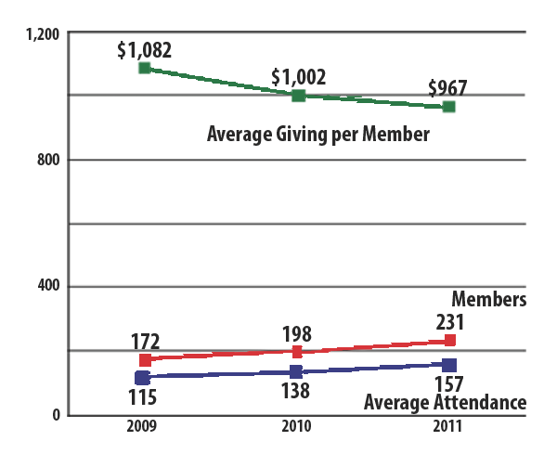
Reporting the Numbers
Membership & Giving Trends

Slide 18
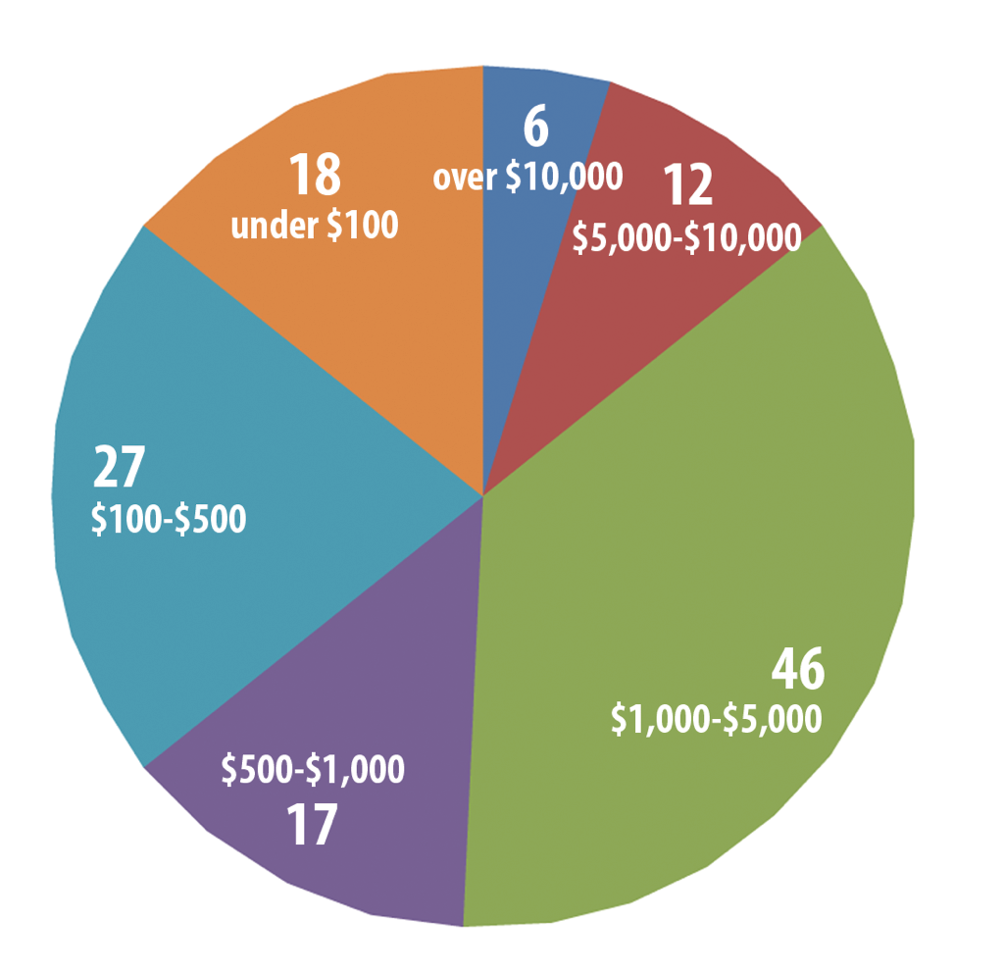
Reporting the Numbers
Our Giving Picture

Slide 19
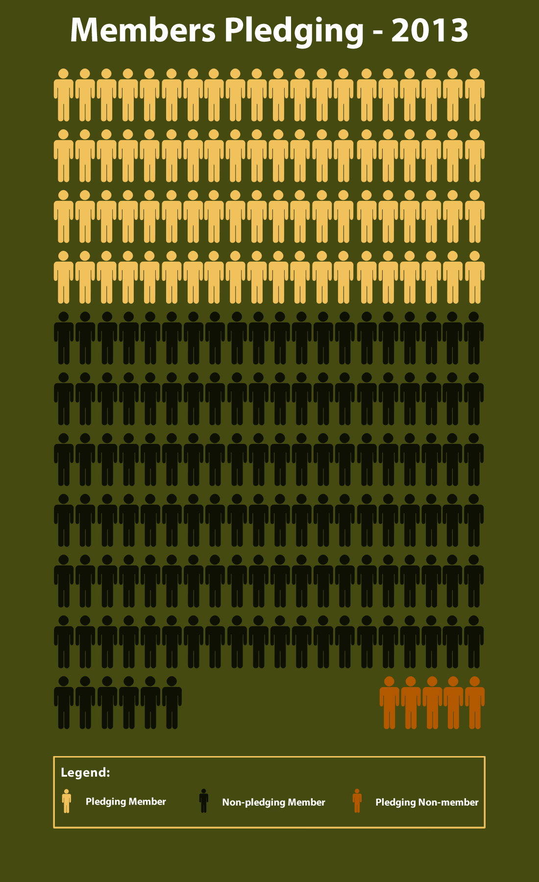
Reporting the Numbers
Our Pledging Picture
Graphic courtesy of
Westminster Congregational UCC
Spokane WA

Slide 20
Growing Generous Givers
1. Giving is a spiritual discipline
2. The pastor needs to know who gives what
3. Make giving easy!!
4. Thank & cultivate your donors!
Send out quarterly statements
Giving is a choice — make sure you make your case!
A note from the pastor can be hugely important
Remember: the widow depends on those with more resources

Slide 21
Inspiring Generosity
The Narrative Budget Page 104
A giving “marketing” document — tell your story!
Does not replace line-item/management financials
More accurately reflects the actual cost of your ministry
Infinitely flexible!

Slide 22
Inspiring Generosity
The Narrative Budget Page 105
1. Determine your frame with a four or five categories
2. Assign expenses to your categories
3. Tell your story in many ways
Gather photographs!
Use pie charts and other graphics
Use easy-to-read bullet-point lists
Avoid too much narrative

Slide 23
Church Money Management
Overview
1. 10 Important Documents
2. Protecting the Organization
3. The Treasurer’s Role
4. Protecting the Church’s Funds
5. Protecting Your People
6. Protecting Your Building & Grounds

Slide 24
Church Money Management
Ten Important Documents
1. Articles of Incorporation
2. Constitution & Bylaws
3. Minutes of all meetings
4. Annual Meeting reports
5. Member roster
6. Financial records
7. Insurance policies
8. Tax records
9. Employment records
10. Deeds

Slide 25
Church Money Management
Protecting the Church’s Funds Page 47
1. Financial (dual!) controls
2. Financial policies & procedures
3. Gift Acceptance Policy
4. Comprehensive endowment policy
5. Spending from an endowment
6. Audits (p 63)
What audits accomplish
Using the audit checklist to develop financial policies & procedures
Trading audit services with another church

Slide 26
Church Money Management
Protecting Your Building & Grounds
1. Preventing slips, trips & falls
2. Facilities Self-Inspection Checklist
3. Comparing Insurance Coverages
Directors & Officers, Bonding
Misconduct coverage
Volunteer organizations

