Slide 1
God Is Still Building We are here to “Kokua”

Slide 2
CB&LF Brief History
https://youtu.be/Hei6qWm1Iiw

Slide 3
Mission
The mission of the Church Building & Loan Fund (CB&LF) is to assist congregations younger than 30 years, as well as renewing congregations of any age, who are planning to buy either a first house of worship or a land site, or who want to build, renovate, or refinance their church building, meeting house, school, parsonage and/or other church buildings.

Slide 4
Vision
2015 - 2017
Reinvent the concept of “church” through innovative uses of buildings and space, unique partnerships and biblical principles to dramatically increase the economic, social, environmental and spiritual vitality of poor communities and gentrifying neighborhoods.

Slide 5
Who can borrow from CB&LF?
New and renewing Christian church organizations that are 30 years or younger
Churches seeking financing to buy, build, construct, renovate or refinance property
Churches with demonstrated capable leadership and commitment to mission and ministry outreach
Churches that participate actively in PIB

Slide 6
Services Provided By CB&LF
Visioning and Strategic Plan of Implementation
Development Consulting: Partners In Visioning (PIV)
Project and Loan Preparation: Partners In Building (PIB)
New Church Loans: Partners In Mission (PIM)
Capital and Stewardship Campaign Consultants
Building Project Loans

Slide 7
Three Keys to Better Church Financial Management
1. Financial Reporting
2. Planning and Forecasting
3. Capital (Asset) Management

Slide 8
FINANCIAL REPORTING
The financial statements should be representative of all the church activity for the respective period (month, year, etc.)
Provide CB&LF with church budget, income statement and balance sheet

Slide 9
FINANCIAL REPORTING
Are all revenue and expenses recorded when incurred?
Are separate operations accounted for distinctly?
Are financial statements audited every year?
Is the chart of accounts consistent with the budget template?
Are key services provided by church members accounted for?

Slide 10
PLANNING & FORECASTING
In order to carry out the mission of the church and achieve its goals….
The church must be able to effectively estimate both future revenue and future expenses
The efforts put into accounting and data management will pay dividends in the end

Slide 11
PLANNING & FORECASTING
The (Narrative) Budget:
A well-constructed budget expresses or demonstrates:
- The Mission Statement
- Transparent communication
- An opportunity to get buy-in for the mission
- An opportunity to dream together

Slide 12
CAPITAL MANAGEMENT
Does the church encourage (and facilitate) membership to fulfill pledges monthly?
Does the church throw away money on excessive interest charges, late fees and/or insufficient funds charges?
Does the church have reserves equal to twelve months expenses?
Does the church have a capital budget?

Slide 13
CAPITAL MANAGEMENT
In order to plan and forecast well, it is important to understand the key resources of the church AND you need it for the loan application!
Is weekly worship attendance recorded?
Is there a membership database?
Is it up to date?
What demographics does it include?
Does it include the calling of individual members?
How is non-church activity (e.g. rentals, bingo, fund-raising) tracked?
Is leadership aware of the various assets in the congregation?

Slide 14
Loan Services Provided By CB&LF
Loans:
Site Purchase
Construction
Building Purchase
Expansion of Facilities
Building Renovations
Refinancing

Slide 15
Current Interest Rates
Building Purchase Loans Interest Rate: 4.25% Term: Five Years (fixed)
Site Loans Interest Rate: 4.75% Term: Five Years (fixed)
Construction/Renovation Loans Interest Rate: 4.75% Term: Five Years (fixed)

Slide 16
Current Interest Rates
Refinance Interest Rate: negotiable Term: 20-30 years
Small Loan Interest Rate: 4.75% Term: Up to 10 Years
Church Building Energy & Environmental Program Interest Rate: 4.25% - 5.375% Term: 5 – 7 Years
Church Building Disaster Recovery Program Interest Rate: 3.25% - 4.75% Term: 20 – 30 Years

Slide 17
Partnership with Cornerstone
Churches and Church Related Faith Based Organizations get the benefit of the CB&LF and The Cornerstone Fund Partnership:
Together we:
Market and Share Resources
Collaborate with other faith based funds
Provide Opportunities for Congregations to Learn and Grow
Together we help You:
Navigate
Identify

Slide 18
Current Partners and Growing
HAWAII CONFERENCE FOUNDATION
WOMAN'S BOARD OF MISSIONS
LANA'I UNION CHURCH
KEOLAHOU CONGREGATIONAL
IAO UNITED CHURCH OF CHRIST FKA
KA' AHUMANU CHURCH
BREAD OF LIFE UCC
SAMOAN CONGREGATIONAL CHRISTIAN
KALAPANA MAUNA-KEA / FIRST HAWAIIAN
WAIMEA UNITED CHURCH OF CHRIST

Slide 19
Current Partners and Growing
WAIOLA UNITED CHURCH OFCHRIST
SAMOAN CHURCH OF HAWAII LMS
Maui Marshallese Ministry
Amataga Fou Church
Kanana Fou CCCAS, UCC
Kahikuonalani Church
Malamalama Ole Alofa-Tunoa
Honolulu Cosmopolitan Church, UCC ,

Slide 20
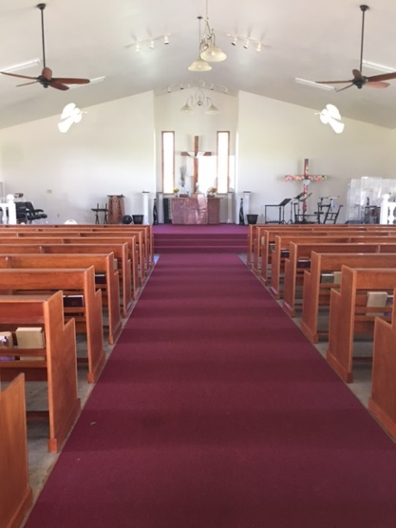
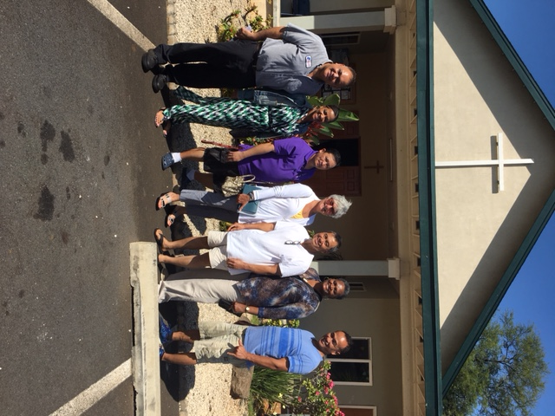
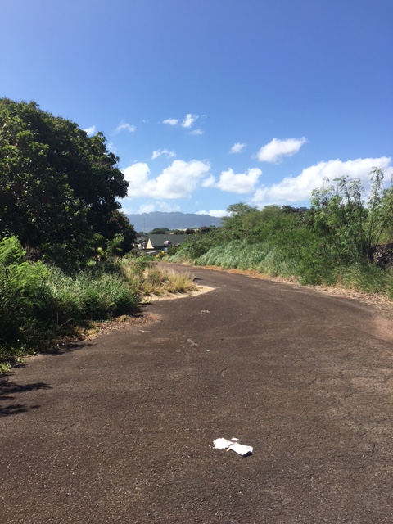
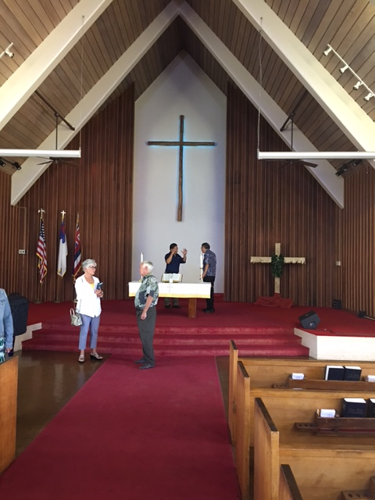
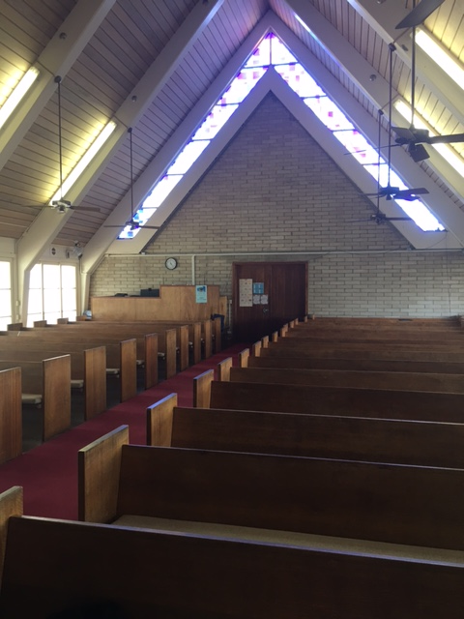
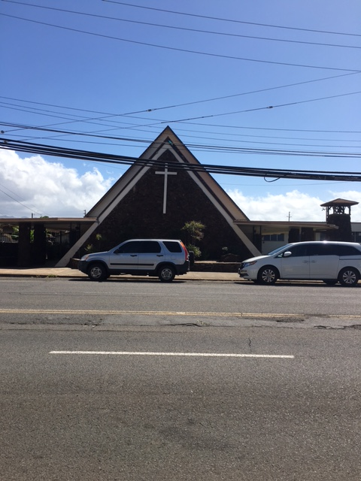
And Growing

Slide 21
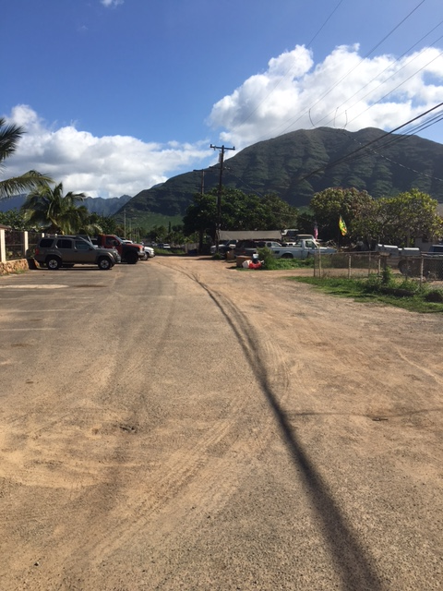
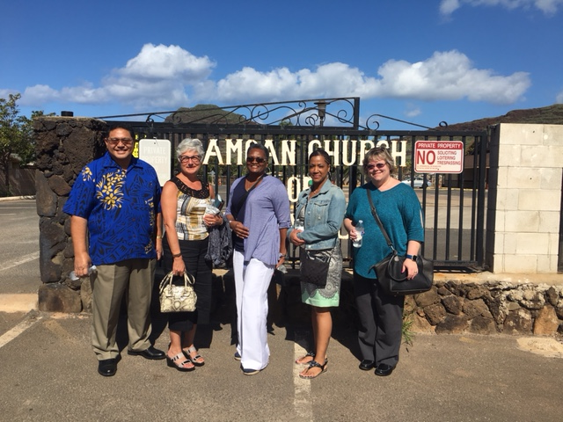
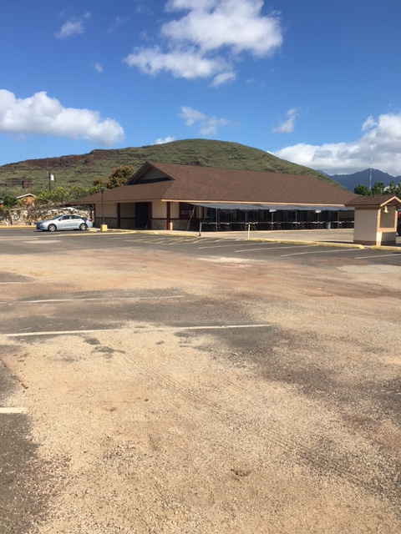
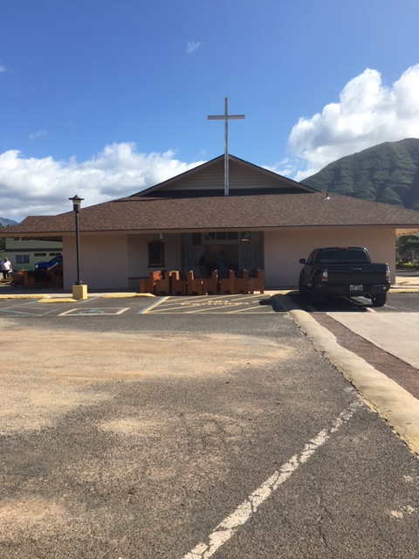
And Growing

Slide 22
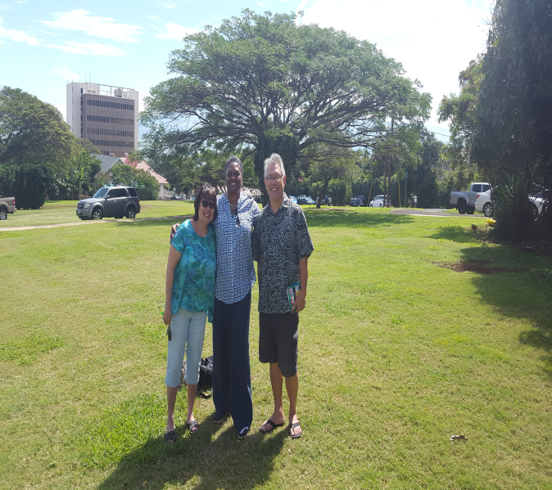
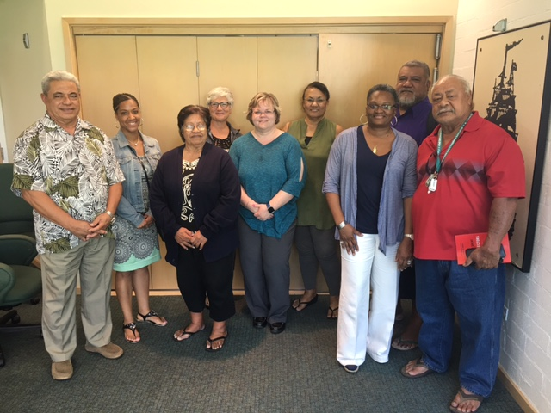
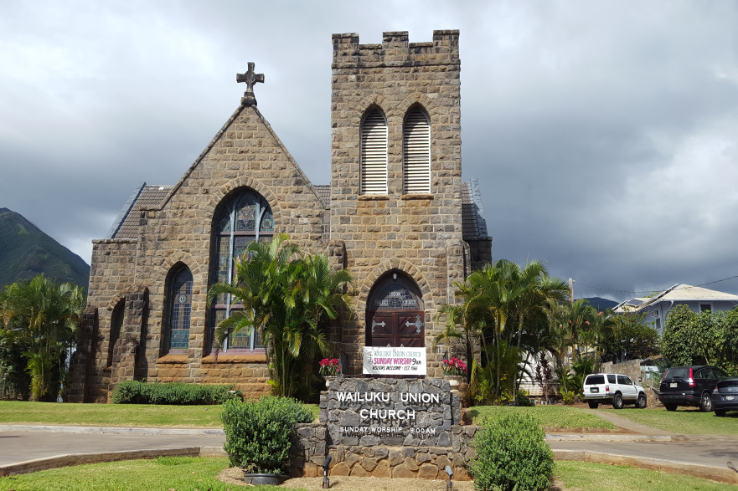
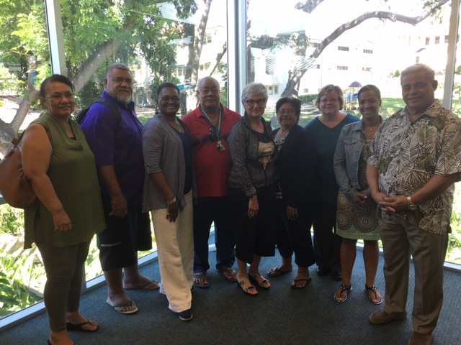
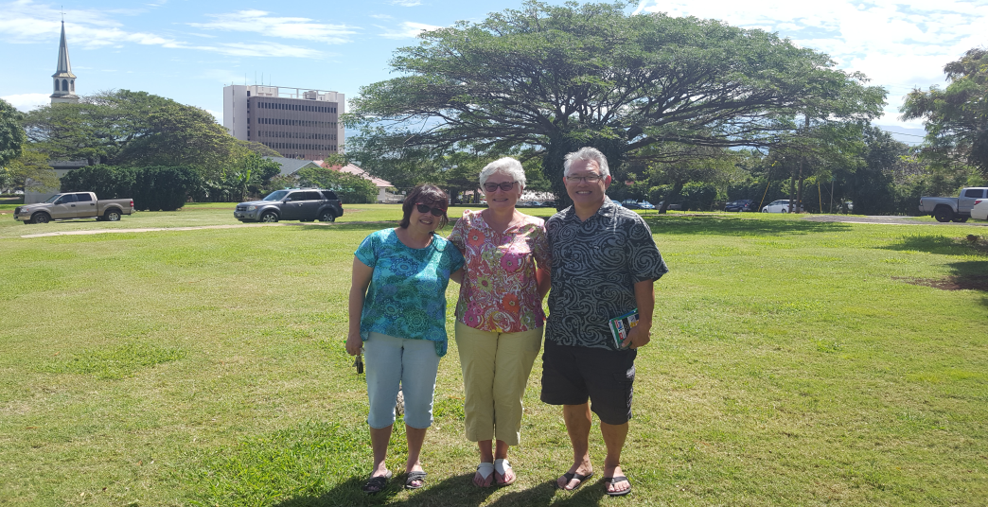
And Growing

Slide 24
Church Building & Loan Fund Staff
Rev. Dr. Patrick Duggan Executive Director, dugganp@ucc.org 216.736.3833
Rev. Susan Mitchell Associate Director, Strategic Initiatives mitchells@ucc.org 216.736.3819
Ms. Shaena Ragin, Senior Loan Specialist, ragins@ucc.org, 216.736.3822
Ms. Erin Frameli, Mortgage Loan Services Coordinator, framelie@ucc.org 216.736.3858
Ms. Donyale Copeland, Office Administrator, copeland@ucc.org 216.736.3834
Mr. David Balthis, Mortgage Loan Accountant, balthisd@ucc.org 216.736.2158

