Slide 1
God Is Still Building We are here to “Kokua”

Slide 2
Deploying Assets For Mission
Mission
The mission of the Church Building & Loan Fund (CB&LF) is to assist congregations younger than 30 years, as well as renewing congregations of any age, who are planning to buy either a first house of worship or a land site, or who want to build, renovate, or refinance their church building, meeting house, school, parsonage and/or other church buildings.

Slide 3
Deploying Assets For Mission
Vision 2015 - 2017
Reinvent the concept of “church” through innovative uses of buildings and space, unique partnerships and biblical principles to dramatically increase the economic, social, environmental and spiritual vitality of poor communities and gentrifying neighborhoods.

Slide 4
So you have been called, You have a Mission, Vision & Ministry….Now What?

Slide 5
Doubt or Determination
Exodus: 4:1
“Moses answered, “What if they do not believe me or listen to me and say, ‘The Lord did not appear to you’?”

Slide 6
Unrecognized Resources
Exodus 4:2 Running from God Resources
“Then the Lord said to him, “what is that in your hand?” “A Staff,” he replied. The Lord said, “Throw it on the ground.” Moses threw it on the ground and it became a snake and he ran from it.

Slide 7
Unrecognized Resources
Exodus: 4:4 Our Hands…God’s Resources
“Then the Lord said to him, “Reach out your hand and take it by the tail.” So Moses reached out and took hold of the snake and it turned back into a staff in hand.”

Slide 8
Fear or Faith
Exodus 4:5 “This,” said the Lord, “is so that they may believe that the Lord , the God of their fathers, the God of Abraham, the God of Isaac and the God of Jacob has appeared to you”

Slide 11
Ready, Set, Go….
Mission Community Impact:
How will your church organization impact the economic, social, environmental and spiritual vitality of poor communities and gentrifying neighborhoods that you touch?

Slide 12
Mission Community Impact:
What innovative uses of buildings & space would scale up the impact of your mission & ministry?

Slide 13
Deploying Assets for Mission
How can CB&LF work with you to re-invent the concept of church?
Services
Visioning and Strategic Plan of Implementation
Development Consulting: Partners In Visioning (PIV)
Project and Loan Preparation: Partners In Building (PIB)
New Church Loans: Partners In Mission (PIM)
Capital and Stewardship Campaign Consultants

Slide 14
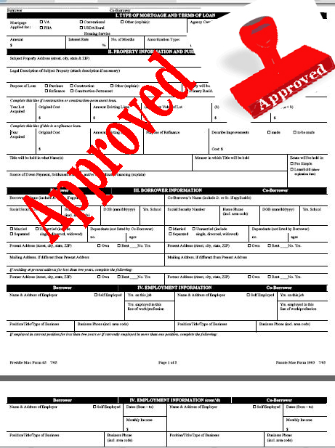
Deploying Assets for Mission
How can CB&LF work with you to re-invent the concept of church?
Loans:
Site Purchase
Construction
Building Purchase
Expansion of Facilities
Building Renovations
Refinancing

Slide 15
Who can borrow from CB&LF
New and renewing Congregations and Church Related/Faith Based organizations that are 30 years or younger
Churches seeking financing to buy, build, construct, renovate or refinance property
Churches with demonstrated capable leadership and commitment to mission and ministry outreach
Churches that participate actively in PIB

Slide 16
Things you can do now!
Develop your Mission, Vision and Strategic Plan of Implementation (Dream Big!)
Include the entire congregation and the community
The Building Fund!
Start raising money well in advance
For your down payment
For out of pocket costs
For mortgage payment reserves

Slide 17
Current Interest Rates
Building Purchase Loans Interest Rate: 4.25% Term: Five Years (fixed)
Site Loans Interest Rate: 4.75% Term: Five Years (fixed)
Construction/Renovation Loans Interest Rate: 4.75% Term: Five Years (fixed)

Slide 18
Current Interest Rates
Refinance Interest Rate: negotiable Term: 20-30 years
Small Loan Interest Rate: 4.75% Term: Up to 10 Years
Church Building Energy & Environmental Program Interest Rate: 4.25% - 5.375% Term: 5 – 7 Years
Church Building Disaster Recovery Program Interest Rate: 3.25% - 4.75% Term: 20 – 30 Years

Slide 19
God Is Still Building We are here to “Kokua”

Slide 21
Church Building & Loan Fund Staff
Rev. Dr. Patrick Duggan Executive Director, dugganp@ucc.org 216.736.3833
Rev. Susan Mitchell Associate Director, Strategic Initiatives mitchells@ucc.org 216.736.3819
Ms. Shaena Ragin, Senior Loan Specialist, ragins@ucc.org, 216.736.3822
Ms. Erin Frameli, Mortgage Loan Services Coordinator, framelie@ucc.org 216.736.3858
Ms. Donyale Copeland, Office Administrator, copeland@ucc.org 216.736.3834
Mr. David Balthis, Mortgage Loan Accountant, balthisd@ucc.org 216.736.2158

